Slide 1
Basics
Primitive Types, values, operations, and Also Tuples.

Slide 2
Primitive Types
real – floating point numbers. Several forms are possible. One form has the following structure:
digit⁺ . digit⁺
int = { min, …, ~2, ~1, 0, 1, 2, … max }
bool = { false, true }
string – sequences of characters enclosed in double quotes. For example,
“hello world”
Note that some characters (e.g., backslash) have special meaning.

Slide 3
char – an expression of the form #s where s is a string of length 1.
#“a”
unit = { () }
  Often referred to as void in imperative languages.
User defined types are also possible and will be discussed later.

Slide 4
Equality types
In SML, an equality type is a type for which the equality operation is defined. Note that the type real is not an equality type. However, the following primitive types are equality types.
int
bool
char
string

Slide 5
Precedence and associativity
The precedence table shown below provides the basis for inserting/omitting parenthesis from basic expressions.
operator | precedence | associativity
not, ~ | highest | left
∗, div, mod | 7 | left
+, − | 6 | left
=, <>, <, >, <=, >= | 4 | left
andalso | -1 | left
orelse | -2 | left

Slide 6
Evaluation of expressions
5 + 6 ∗ 7 < 48
→ 5 + 42 < 48
→ 47 < 48
→ true

Slide 7
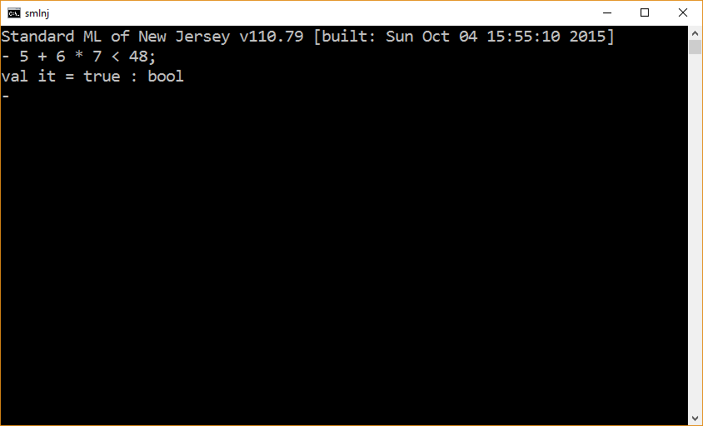

Slide 8
Tuples
A heterogeneous aggregation mechanism

Slide 9
The form of a tuple
A tuple is a comma separated sequence of 2 or more expressions enclosed in parenthesis.
tuple ::= ( exprList )
exprList ::= expr , exprList
| expr , expr

Slide 10
Example – tuple values
Let v₁, …, v_{n} denote n values which may be of different types, where n ≥ 2.
Then ( v₁, …, v_{n} ) is a tuple value.
Note that tuple values contain parenthesis and at least one comma.
Tuple types contain at least one ∗
Tuple | Type
(1,2,3) | int ∗ int ∗ int
(1, true) | int ∗ bool
(“hello”, 1) | string ∗ int

Slide 11
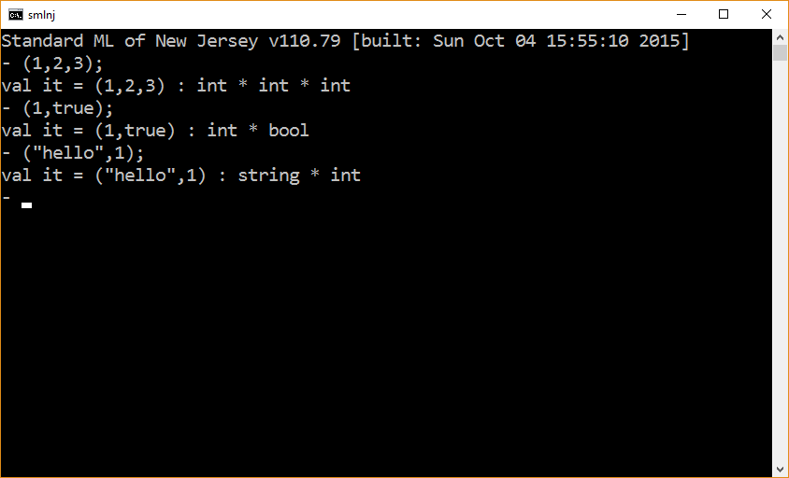

Slide 12
Tuple wannabes
Expression | Comment
(1) | An arithmetic expression whose value is 1.
() | The unit value (aka void).

Slide 13
Evaluation of Tuples
The expression sequence forming a tuple is evaluated from left-to-right.
Evaluation stops when a tuple value has been reached.
(1∗10, 2∗10, 3∗10)
→ (10, 2∗10, 3∗10)
→ (10, 20, 3∗10)
→ (10, 20, 30)

Slide 14
Validating Evaluation order
The signature of the print function is as follows.
print: string -> unit

Slide 15
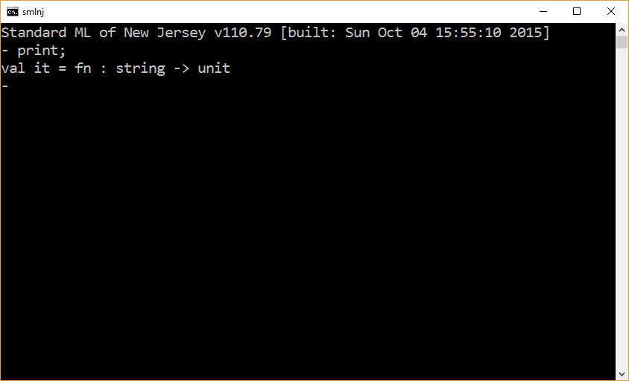

Slide 16
(print “first\n”, print “second\n”, print “third\n”);
(
print “first\n”,
print “second\n”,
print “third\n”
);

Slide 17
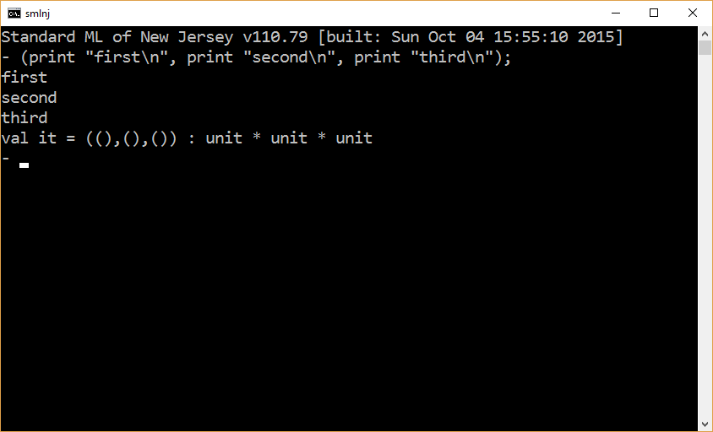

Slide 18
Equality Types
The type of a tuple is an equality type if and only if the type of every expression in the tuple is an equality type.
Tuple Type | Equality Type
int ∗ int ∗ int | yes
int ∗ string | yes
int ∗ real ∗ int | no

Slide 19
Tuple Operations – there is only 1
Let t denote a tuple containing n expressions where n ≥ 2.
Let i denote an integer such that 1≤ i ∧ i ≤ n.
The expression #i t denotes the i^{th} element of the tuple t.
The tuple access operator #i is composed of two tokens (# and i) and behaves like a function – its application has the same precedence (highest) and associativity (left) as a function.
Aside. From a technical standpoint, tuples are a special case of a record structure.

Slide 20
Tuple expression | Result (i.e., value)
#1(10,20,30) | 10
#2(1,true) | true
#3(1,true,“hello”) | “hello”
#1( (true, “hello”),2) | (true, “hello”)
#2(“x”, (“int”, 7)) | (“int”,7)

Slide 21
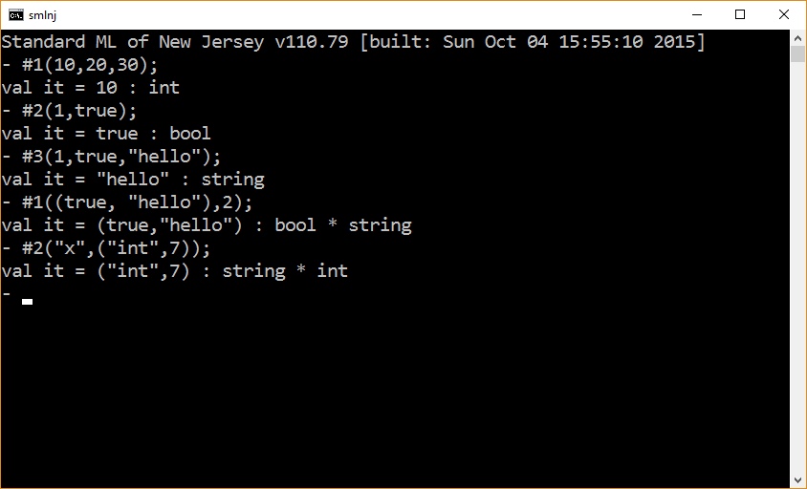

Slide 22
Static Properties
The number of elements in a tuple cannot be changed dynamically.
  All tuple sizes in a program are known statically.
The i in a tuple access operation must be an integer constant – it cannot be a variable whose value is computed dynamically.

Slide 23
Tuples versus Java objects
In SML, tuples (and records) and Java objects are similar in some important ways.
The elements of a tuple/object must be accessed using static mechanisms – hashtag and dot.
The number of elements in a tuple/object are fixed at compile time.
Tuple expression | Value
(5,6) | (5,6)
#1(5,6) | 5
#2(5,6) | 6
Java Object | Value
{int x = 5; int y = 6;} | {x = 5; y = 6;}
myA.x | 5
myA.y | 6

Slide 24
The end

